Slide 1

KIM-LNR
Date. 2017-03-15

Slide 2
INDEX
1. Profile & Team introduction
2. About South Korea
3. weakness at Korea Open
4. Program introduction

Slide 3
1. Profile

Slide 4

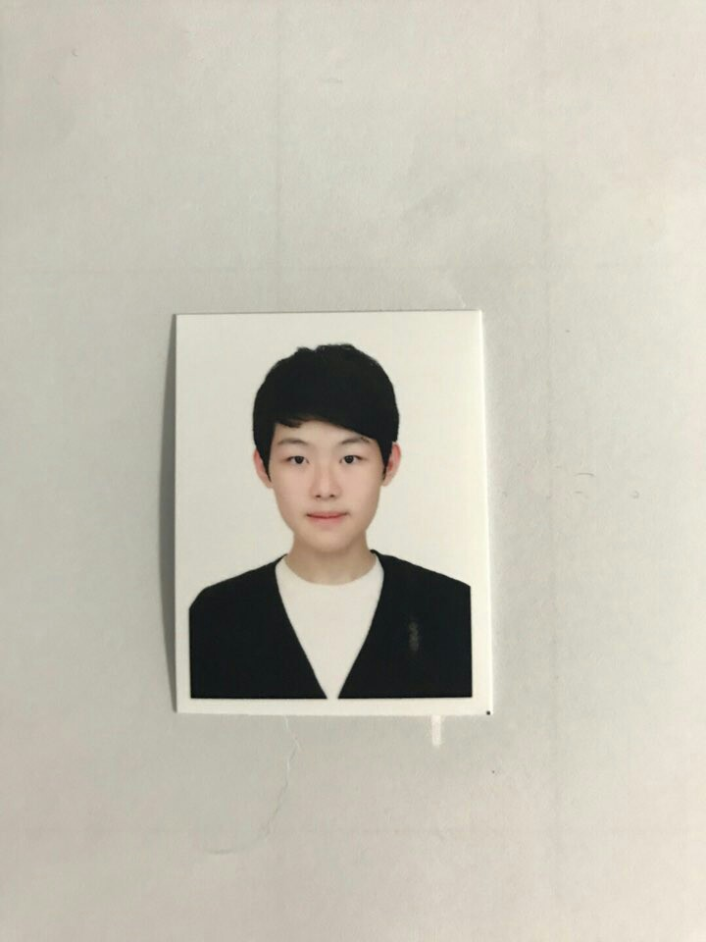
Secondary
Name : Kim bo-kyung
Address : Incheon, Korea
School : Incheon Choeun HighSchool
Aim : We will learn things that we didn't think of.
Name : Park yong-jin
Address : Incheon, Korea
School : Incheon SongDo HighSchool
Aim : My goal is to be a winner of the competition

Slide 5
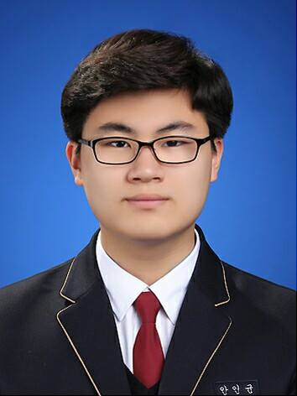

Secondary
Name : Ahn In-gyun
Address : Incheon, Korea
School : Incheon Jinsan Science HighSchool
Aim : Perfect programing & Clear clean cording
Name Lee Na-ra
Address : Incheon, Korea
School : Incheon Choeun HighSchool
Aim : Do programming that was not done in local
competition.

Slide 6
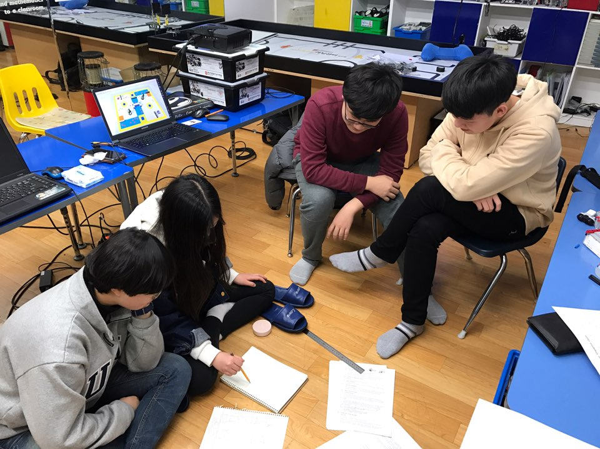
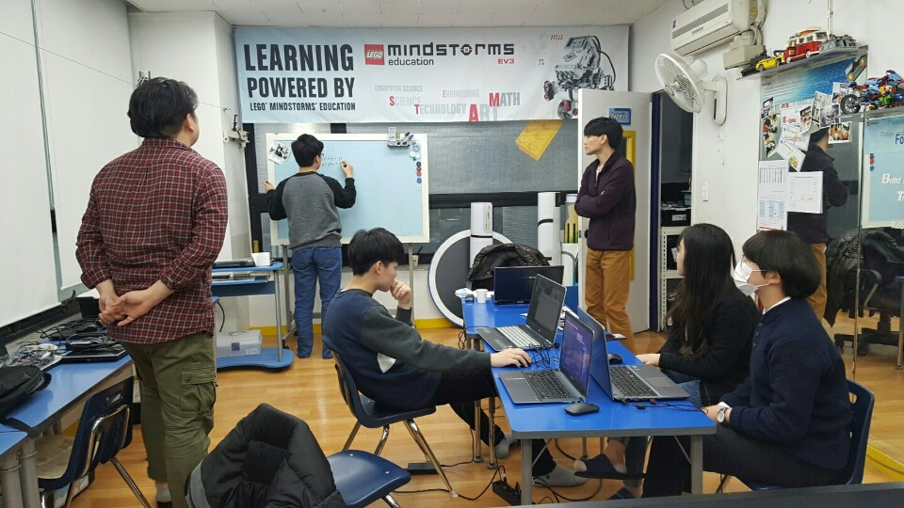
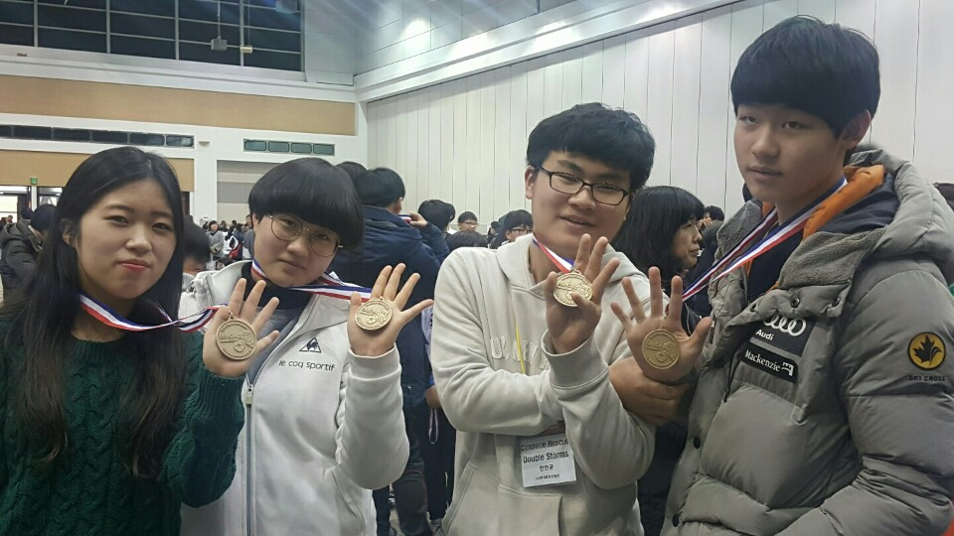

Sam san Lego center
(KIM-LNR) clearly 1st !!!!!

Slide 7
2. About Korea

Slide 8

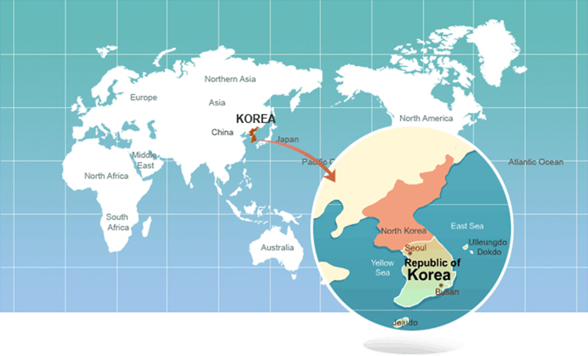
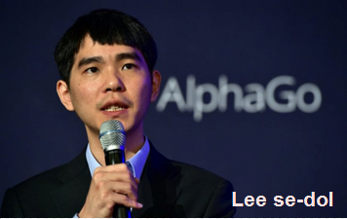
KOREA
Let us introduce where we came from ...
Korea is one of developed country which has a high level of technology.
The companies such as Samsung and Hyundai motors became a world-class organization.
With AlphaGo, they played a game and won 1 to 4 games.
It became the occasion of AI popularization.
Korea is rapidly developing.

Slide 9
3. Weakness
at Korea Open

Slide 10
1) Programing
* We couldn`t check Collection Boxes color sensor
value.
* We had mistakes while coding the statement
from Marker to Collection Boxes.
* We couldn`t complete the programing that track
coordinate.
2) Computer specification
* Movement of the CsBot is affected by computer
specification
We are here to make up for defects!!!

Slide 11
4. Program Introduce

Slide 12

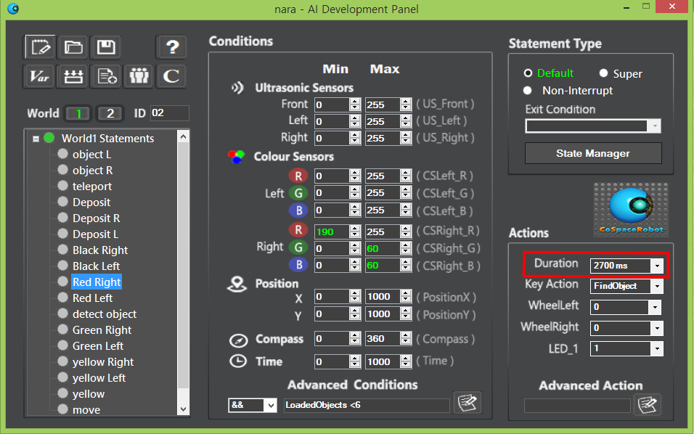
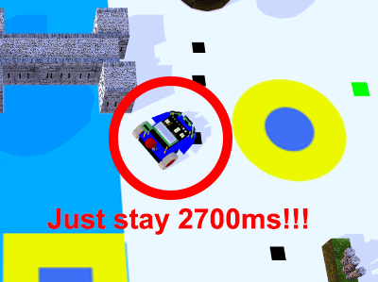
Find object
If CsBot loaded 6 objects, do not load anymore
Duration of Find Object action reduced to 2700ms

Slide 13
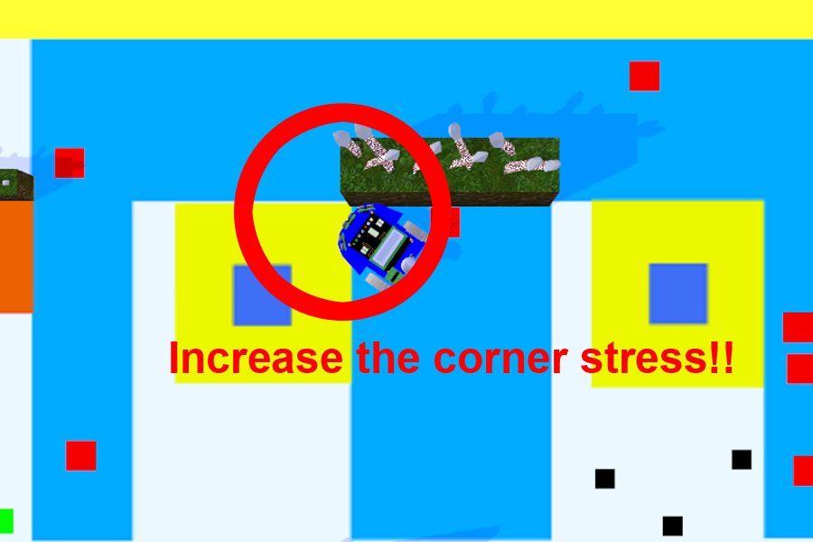
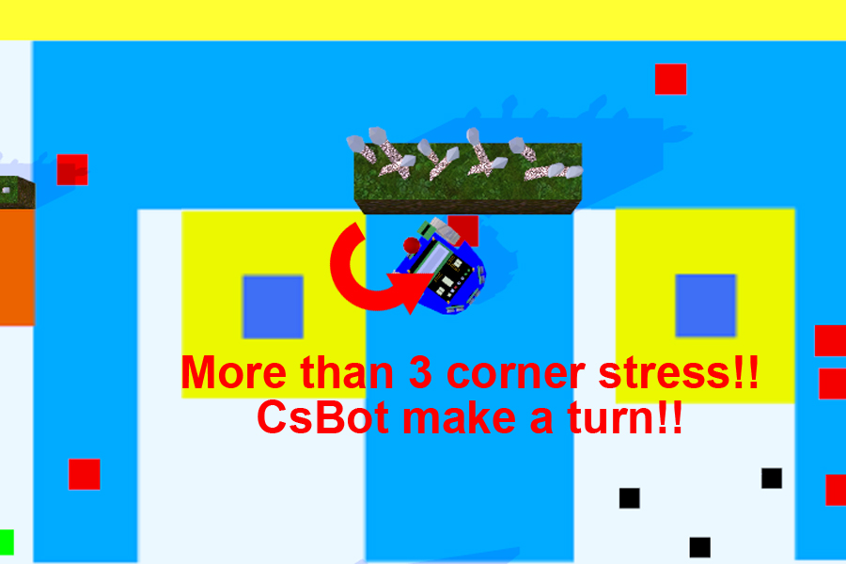
Escape Corner
If approach Obstacle and forward time is less than threshold value, increase Corner stress.
If corner stress is more than 3, turn to opposite side.

Slide 14
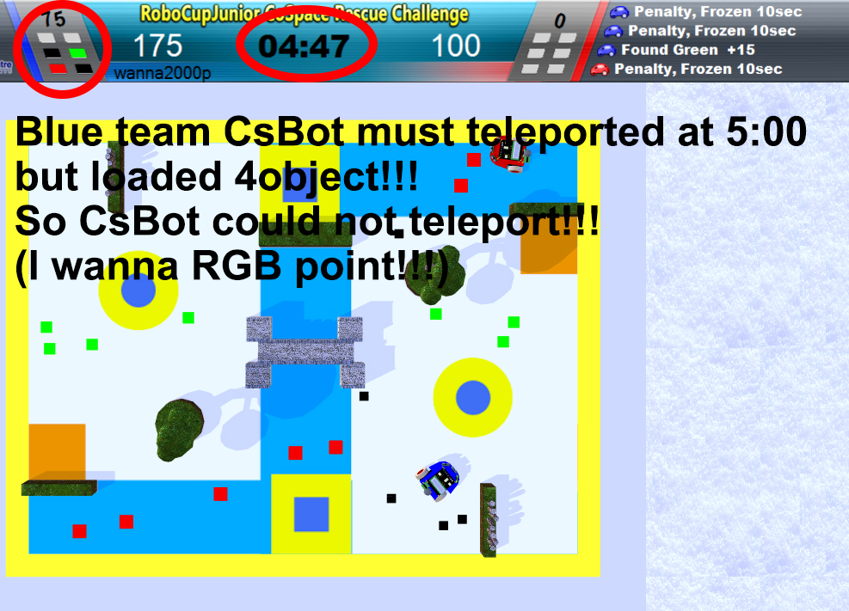
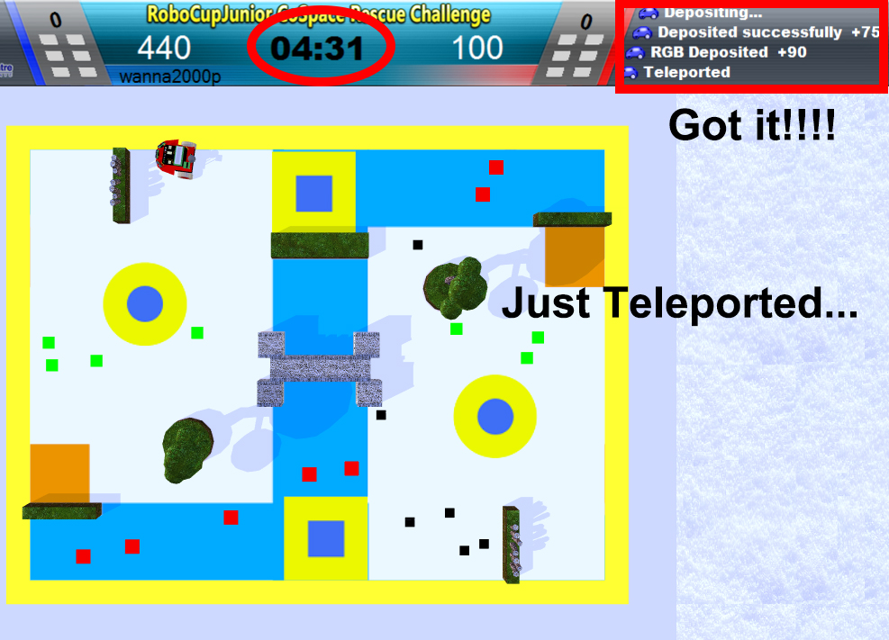
Teleport
If there are more than 4 objects in the world1, teleport to world2 after depositing.
e.g. code : if(loadedObject<3&&Time>When deposit is successful +1sec)

Slide 15
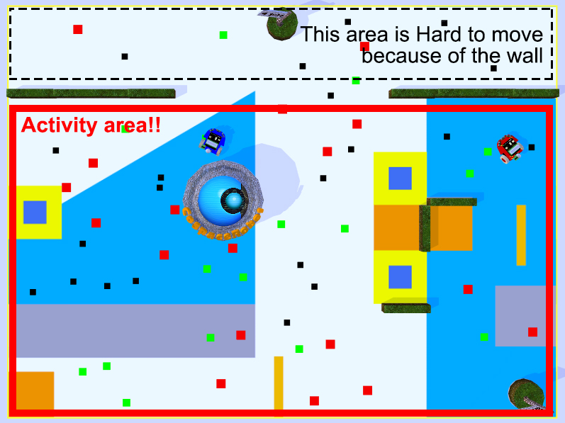
Area setting in world2
CsBot move in the place which World 2 was divided with position X and position Y.

Slide 16
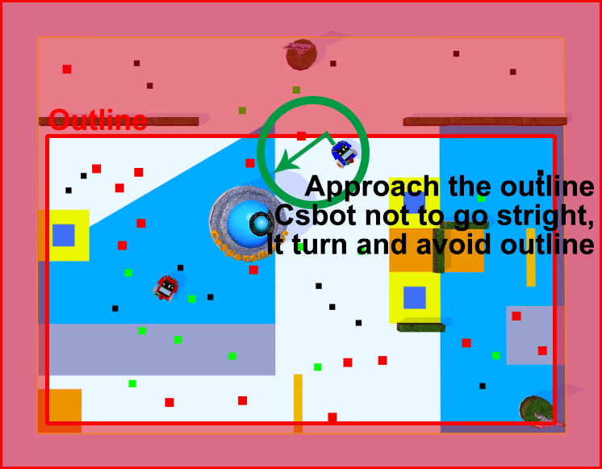
Approach the outline in world2
If CsBot approached the outline, check the current compass value and turn to situation.

Slide 17
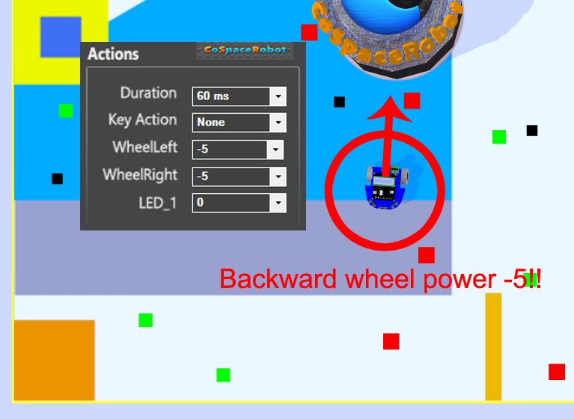
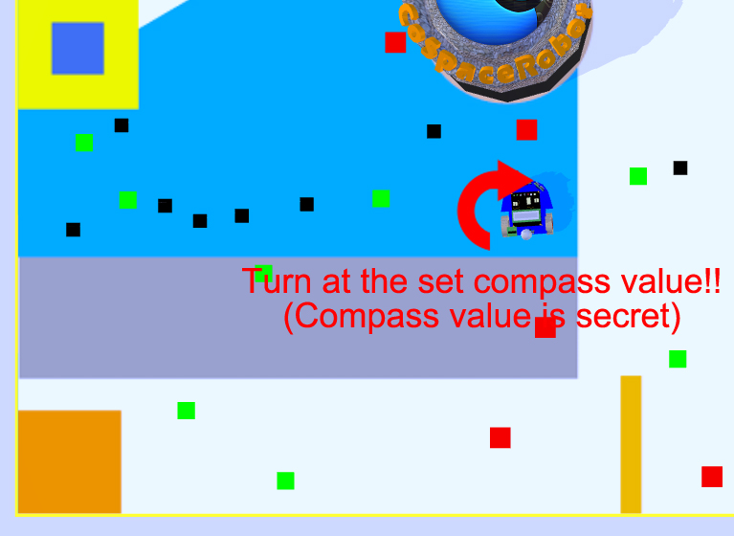
Swampland
If CsBot detected swampland, until Swampland color Left and right wheel power -5 and turns at the set compass value.

Slide 18
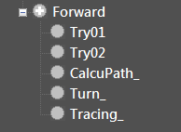
Collection Box Tracing
If CsBot loaded object more than 3 and enter the set area, Enter the collection box to calculate the coordinates of the collection box
It’s collection box tracing statement!!
Ask team coder for more details.

Slide 19
THANK YOU

